Slide 1
2015 3rd International Symposium on Computational
and Business Intelligence
7-9 Dec. 2015
Soft Computing – Final Project Presentation
EHO Compared with GA, PSO in Real Number Optimization Problem
Presenter :
R07546020 鍾偉志
Notes:
簡介演算法建置和使用的Benchmark
比較三種演算法成效
再來是我對於這演算法的一些修正
最後是針對這篇論文的延伸討論

Slide 2
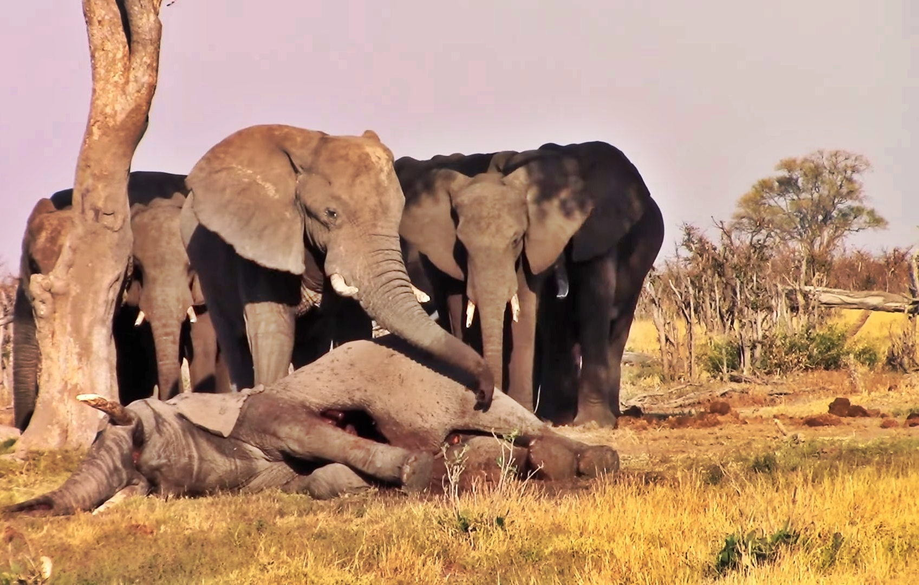


演算法建置 – EHO
Set α = 0.5, β = 0.1, iter = 15, clan = 5, elephant = 15;
Randomly initialize solution;
for i = 1 to iter do
Sorted all solutions by fitness;
for ci = 1 to clan ( for all clans in population ) do
for j = 1 to nci ( for all elephants in clan ci ) do
if j = nci then
end if
end for
end for
Evaluate fitness for population and update the best;
end for
Notes:
更新領袖象 是 中心點到0的距離 的beta倍

Slide 3
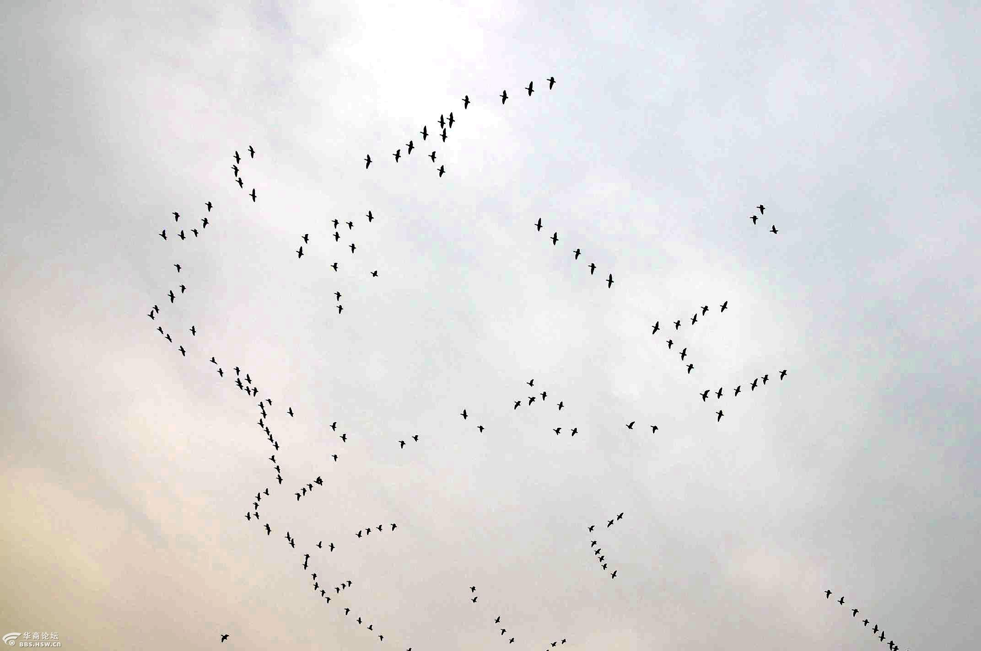

演算法建置 – PSO
Set SocialFactor = 0.5, CognitionFactor = 0.5, iter = 15,
Particles = 15;
Randomly initialize solution;
for i = 1 to iter do
for j = 1 to Particles do
a = CognitionFactor * rnd, b = SocialFactor * rnd;
for k = 1 to Variable do
$x_{new, j, k}=a∗{(x}_{best, j, k} −x_{j, k})+ b∗(x_{best, k} −x_{j, k})$
if $x_{new, j, k}$ > upperbound then
$x_{new, j, k}$ = upperbound
end if
if $x_{new, j, k}$ < lowerbound then
$x_{new, j, k}$ = lowerbound
end if
end for
end for
Evaluate fitness for population and update the best;
end for

Slide 4

`
演算法建置 – GA
Set crossoverRate = 0.8, mutationRate = 0.05, iter = 15, population = 15;
Randomly initialize solution;
for i = 1 to iter do
onePointCutOperation;
mutationOperation;
decodingSolutionFromBinary;
arithmeticalOperation;
Evaluate fitness for population and update the best;
Sorted all solutions by fitness;
SelectionOperation;
end for

Slide 5
比較三種演算法成效
Name | GA |  | PSO |  | EHO
 | Mean + Std | Best | Mean + Std | Best | Mean + Std | Best
Girewank (30) | 87.47 + 38 | 22.32 | 95.41 + 24.26 | 52.74 | 1 + 0 | 1
GoldsteinPrice | 5.85 + 12.21 | 3 | 20.56 + 27.91 | 3 | 5.65 + 2.66 | 3.03
Peak (2) | -6.15 + 0.88 | -6.55 | -5.45 + 1.6 | -6.55 | -6.45 + 0.14 | -6.55
Rastrigin (30) | 422.89 + 99.7 | 266.42 | 487.35 + 77.2 | 342.58 | 0.62 + 0.19 | 0.29
Rosenbrock (30) | 4.75+5.44 (10^5) | 41878 | 4.98+2.27(10^5) | 86741 | 29.86 + 0.03 | 29.78
Schwefel (30) | 9351 + 645.49 | 7169 | 10246 + 618.89 | 8285.97 | 9887 + 419.22 | 8742.21
Six-humpCamel | -1 + 0.11 | -1.03 | -0.98 + 0.12 | -1.03 | -1.01 + 0.03 | -1.03
Notes:
象群不斷換領袖、群跟群之間沒有關係，等於避免單一陷入區域解，可以陷入多點機率，但不確保不陷入相同區域
時間大概是10倍關係，但成效差
GA彈跳變異太大 適合找好的解、但十分費時

Slide 6
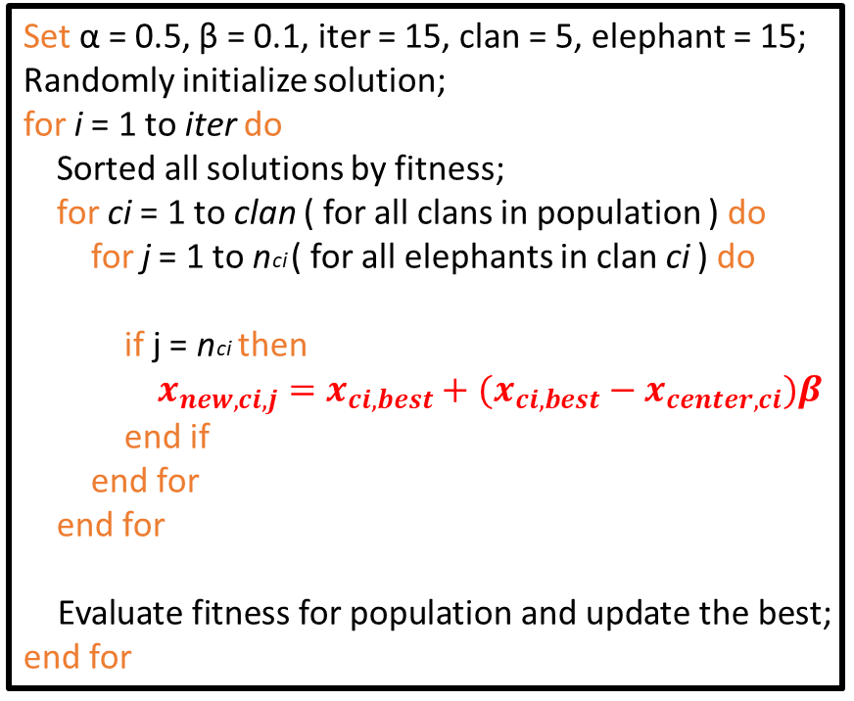
改善EHO – 比較修正前後成效
Before
After
Set α = 0.5, β = 0.1, iter = 15, clan = 5, elephant = 15;
Randomly initialize solution;
for i = 1 to iter do
Sorted all solutions by fitness;
for ci = 1 to clan ( for all clans in population ) do
for j = 1 to nci ( for all elephants in clan ci ) do
if j = nci then
end if
end for
end for
Evaluate fitness for population and update the best;
end for
Set α = 0.5, β = 0.1, iter = 15, clan = 5, elephant = 15;
Randomly initialize solution;
for i = 1 to iter do
Sorted all solutions by fitness;
for ci = 1 to clan ( for all clans in population ) do
for j = 1 to nci ( for all elephants in clan ci ) do
if j = nci then
$x_{new,ci,j}=x_{ci,best}+(x_{ci,best}−x_{center,ci})β$
end if
end for
end for
Evaluate fitness for population and update the best;
end for
Notes:
讓最佳解 往群中心的反方向移動，移動量為beta
避免向單一點集中(0)
但很有可能一直不更換領袖
可預測: 如最佳解為0的會變差，不為0的會較好

Slide 7
改善EHO – 比較修正前後成效
Name | EHO |  | EHO - Adjust
 | Mean + Std | Best | Mean + Std | Best
BraninsRcos | 0.45 + 0.07 | 0.4 | 0.4 + 0 | 0.4
Girewank (30) | 1 + 0 | 1 | 49.12 + 11.13 | 24.97
GoldsteinPrice | 4.97 + 2.14 | 3.02 | 3.01 + 0.02 | 3
Peak (2) | -6.49 + 0.08 | -6.55 | -6.55 + 0 | -6.55
Rastrigin (30) | 0.63 + 0.18 | 0.22 | 349.32 + 31.86 | 257.57
Rosenbrock (30) | 29.85 + 0.03 | 29.79 | 1.17 + 0.41(10^5) | 36957.5
Schwefel (30) | 9927 + 414.67 | 8256.85 | 9096.52 + 441.43 | 8055.02
Six-humpCamel | -1.01 + 0.02 | -1.03 | -1.03 + 0 | -1.03
Notes:
跑100次 計算各iter的平均

Slide 8
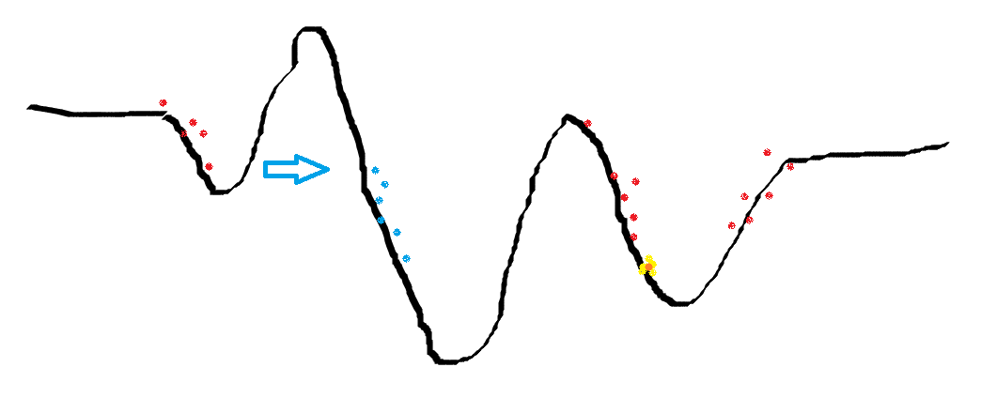
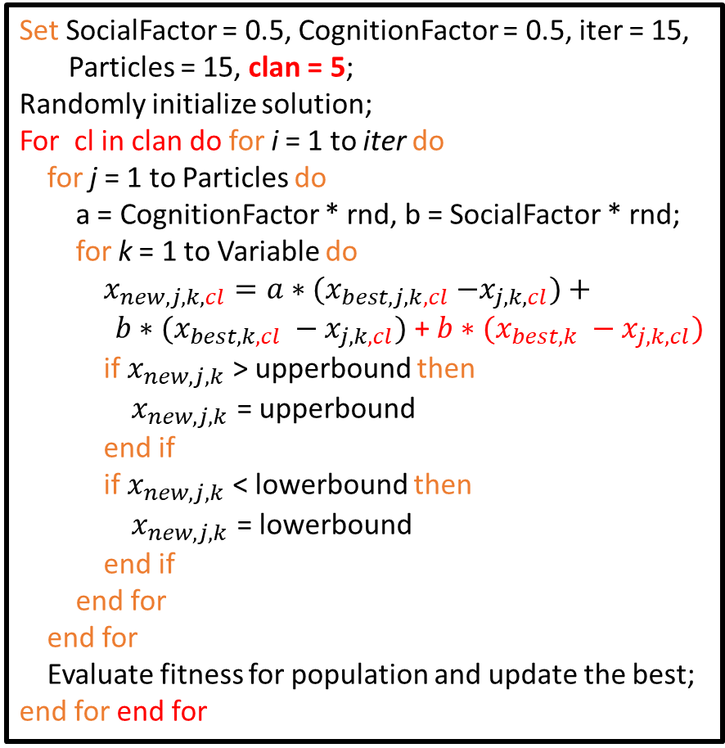
比較三種演算法成效 – 使用改善PSO和EHO
Set SocialFactor = 0.5, CognitionFactor = 0.5, iter = 15,
Particles = 15, clan = 5;
Randomly initialize solution;
For cl in clan do for i = 1 to iter do
for j = 1 to Particles do
a = CognitionFactor * rnd, b = SocialFactor * rnd;
for k = 1 to Variable do
$x_{new, j, k,cl}=a∗{(x}_{best, j, k,cl} −x_{j, k,cl})+ b∗(x_{best, k,cl} −x_{j, k,cl})$ + $b∗(x_{best, k} −x_{j, k,cl})$
if $x_{new, j, k}$ > upperbound then
$x_{new, j, k}$ = upperbound
end if
if $x_{new, j, k}$ < lowerbound then
$x_{new, j, k}$ = lowerbound
end if
end for
end for
Evaluate fitness for population and update the best;
end for end for
Best one
以整體領袖更新每個燕子
Notes:
這邊我們還發現明顯PSO也可以進行改善
就是把象群體的概念，多個燕群避免單一區域解，可以飛向多個區域
這邊跟象群不太一樣的地方是
我在更新的時候參考的不只該群領袖，還有整體燕群最佳解
期望可以更有機會多探幾個區域，避免卡在較差的區域解

Slide 9
比較三種演算法成效 – 使用改善PSO和EHO
Name | GA |  | PSO |  | EHO
 | Mean + Std | Best | Mean + Std | Best | Mean + Std | Best
BraninsRcos | 0.57 + 0.54 | 0.4 | 0.48 + 0.23 | 0.4 | 0.4 + 0.01 | 0.4
Girewank (30) | 76.65 + 36.16 | 26.76 | 28.73 + 7.25 | 15.26 | 47.7 + 9.4 | 24.26
GoldsteinPrice | 5.77 + 12.32 | 3 | 3.01 + 0.06 | 3 | 3.01 + 0.03 | 3
Himmelblau | 1.47 + 3.35 | 0 | 0.15 + 0.76 | 0 | 0.01 + 0.02 | 0
Peak (2) | -6.33 + 0.59 | -6.55 | -6.54 + 0.15 | -6.55 | -6.55 + 0 | -6.55
Rastrigin (30) | 440.61 + 105.25 | 283.8 | 332.51 + 39.24 | 201.65 | 353.13 + 27.61 | 307.09
Rosenbrock (30) | 4.85+6.5 (10^5) | 24431 | 0.83+0.42(10^5) | 14736 | 1.25 + 0.53(10^5) | 29295
Schwefel (30) | 9373.45 + 735.31 | 7222 | 9477 +595.62 | 7951.02 | 9170.4 + 535.89 | 7145.57
Stenger (02) | 0.05 + 0.2 | 0 | 0.01 + 0.03 | 0 | 0 + 0 | 0
Six-humpCamel | -0.99 + 0.13 | -1.03 | -1.03 + 0.02 | -1.03 | -1.03 + 0 | -1.03
Notes:
跑100次 計算各iter的平均

Slide 10
Further Discussion For EHO
領袖象更新避免陷入原點
2. 每個象群的領地避免陷入同個區域解
3. 類似領袖的領袖可以幫助探索更多區域
Notes:
第三個就像PSO一樣
更有策略地去選取初始化解的值

